Slide 1

BUDT703 Section 0507: Team 3
topUmd
Business Analytics Consulting for the University of Maryland, College Park
Members: Aniela Skibniewska, Shu-Ping Chen, Yishang Huang, Anshika Kapoor, Hsinkai Liao
Date: December 03, 2021

Slide 2
Roadmap
Background
Conceptual Database Design
Physical Database Design
1
3
5
2
4
6
Our Mission
Logical Database Design
Use Cases and Application

Slide 3
BACKGROUND
1

Slide 4
Background: Who We Are and Our Data
topUmd
We are a Data Analytics Consulting Firm who specialize in Graduate School Rankings and the various factors involved.
Our Data
We have compiled a list of the top 10 graduate business schools in the United States, according to USNews, and several related factors, mostly pulled from each school’s website:
School Statistics (Location, Graduate Rate, etc)
Faculty
Publications
Donations to each school
Corresponding Other Agency Rankings (QS and Bloomberg)

Slide 5
OUR MISSION
2

Slide 6
Mission Statements
Create a helpful report to answer the question of “How is the university?”
Improve the ranking of the business school of UMD and other top 9 universities
Help make the Smith School to be considered as a top business school in the future

Slide 7
Mission Objectives
Which faculty has taught for the highest number of years, which is their business school, and what is his/her school’s USNews ranking?
What are the faculty and their number of publications, in order of publication amount, for the faculty that have Nobel prizes, and what are their corresponding business schools?
What is the relationship between the USNews ranking and the financial support in terms of donations to the school, in order of donations?
What is the comparison between the USNews Ranking and the average of the agency rankings, in order of USNews Ranking for each business school?
What 5 faculty had the highest number of awards, and what is their corresponding business school’s USNews ranking?
What is the relationship between the proportion of female and international students and the USNews ranking?
What is the relationship between employment rate, salary, and USNews Ranking, in order of employment rate and highest salary?

Slide 8
Conceptual Database Design
3

Slide 9
Conceptual Database Design: Entities, Attributes and Primary Keys
BusinessSchool (busName, busLocation, busNumStudents, busProIntStudents, busProFemStudents, busGrdRate, busEmpRate, busNotableAlum, busAvgSalary)
Donation (donId, donAmount)
Faculty (facName, facNumAwards, facNumProjects, facDomExpert, facYearsTeach, facNumberNobel)
Publication (pubId, pubYear)
RatingAgency (othAgnId, othAgnName, othAgnRate)

Slide 10
Conceptual Database Design: Relationships, Attributes, Degrees, Participating Entities and Constraints
Donate (period): binary relationship
1 Donation record to 1 Business School
1 Business School to 0 or many Donation Record
Work: binary relationship
1 Business School to 1 or many Faculty
1 Faculty to 1 or many Business School
Rate: binary relationship
1 Business School to 0 or many Ratings Agencies
1 Ratings Agency to 0 or many Business Schools
Publish: binary relationship
1 Faculty to 0 or many Publications
1 Publications to 1 or many Faculty

Slide 11
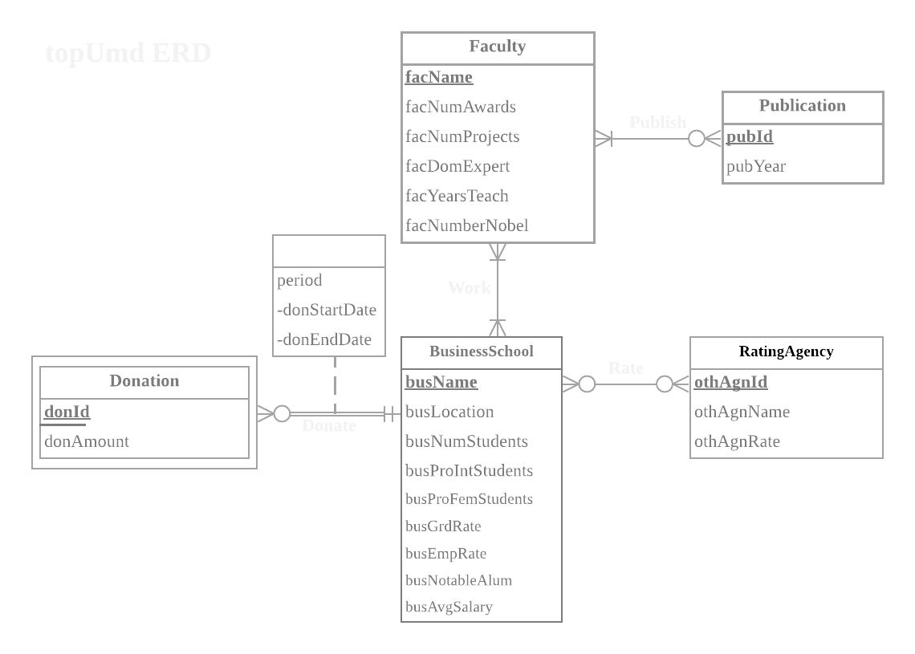
Conceptual Database Design: ER Diagram

Slide 12
Logical Database Design
3

Slide 13
Logical Database Design: Relational Schema
Faculty(facName, facNumAwards, facNumProjects, facDomExpert. facYearsTeach, facNumberNobel)
Publication(pubId, pubYear)
BusinessSchool(busName, busLocation, busNumStudents, busProIntStudents, busProFemStudents, busGrdRate, busEmpRate, busNotableAlum, busAvgSalary)
RatingAgency(othAgnId, othAgnName, othAgnRate)
Donation(busName, donId, donAmount, donStartDate, donEndDate)
Publish(facName, pubId)
Rate(busName, othAgnId)
Work(facName, busName)

Slide 14
Logical Database Design: Functional Dependencies
facName → facNumAwards, facNumProjects, facDomExpert. facYearsTeach, facNumberNobel
pubId → pubYear
busName → busLocation, busNumStudents, busProIntStudents, busProFemStudents, busGrdRate, busEmpRate, busNotableAlum, busAvgSalary
othAgnId → othAgnName, othAgnRate
busName, donId → donAmount, donStartDate, donEndDate
facName, pubId →
busName, othAgnId →
facName, busName →

Slide 15
Logical Database Design: Business Rules
[R1] When a Business School is deleted from or changed in the database, all corresponding Donation data of the business school should be deleted or changed accordingly.
[R2] When a Faculty has published a Publication, then the Faculty and the Publication cannot be deleted or changed in the database.
[R3] When a Business School is deleted from or changed in the database, the Ranking of the business school should be deleted or changed accordingly.
[R4] When a Rating Agency is deleted from or changed in the database, the Rankings provided by the rating agency should be deleted or changed accordingly.
[R5] When a Faculty working at a Business School is deleted from or changed in the database, the data of the Faculty should be deleted or changed accordingly.
[R6] When a Business School is deleted from or changed in the database, the data of the Business School should be deleted or changed accordingly.

Slide 16
Logical Database Design: Referential Integrity Rule/Action Table
Relation | Foreign Key | Base Relation | Primary Key | Business Rule | Constraint: ON DELETE | Business Rule | Constraint: ON UPDATE
Donation | busName | BusinessSchool | busName | R1 | CASCADE | R1 | CASCADE
Publish | facName | Faculty | facName | R2 | NO ACTION | R2 | NO ACTION
Publish | pubId | Publication | pubId | R2 | NO ACTION | R2 | NO ACTION
Rate | busName | BusinessSchool | busName | R3 | CASCADE | R3 | CASCADE
Rate | othAgnId | RatingAgency | othAgnId | R4 | CASCADE | R4 | CASCADE
Work | facName | Faculty | facName | R5 | CASCADE | R5 | CASCADE
Work | busName | BusinessSchool | busName | R6 | CASCADE | R6 | CASCADE

Slide 17
Physical Database Design
4

Slide 18
Physical Database Design: Data Types used
INTEGER
DECIMAL(3, 3)
DECIMAL(9, 2)
DECIMAL(10, 2)
DATE
CHAR(10)
VARCHAR(10)
VARCHAR(20)
VARCHAR(30)
VARCHAR(40)
VARCHAR(50)

Slide 19
Physical Database Design: Distinct Data Values - Business School
Stanford University
University of Pennsylvania (Wharton School)
Northwestern University (Kellogg School of Management)
University of Chicago (Booth School of Business)
Massachusetts Institute of Technology (Sloan School of Management
Harvard University
University of California, Berkeley (Haas School of Business)
Columbia University
Yale University
University of Maryland (Smith School of Business)

Slide 20
Physical Database Design: Distinct Data Values - Rating Agency
US News
QS
Bloomberg

Slide 21
Physical Database Design: Sequence of DROP TABLES
Rate >> AgencyRanking >> Donation >> Work >> Publish >> Publication >> Faculty >> BusinessSchool
SQL code:
DROP TABLE IF EXISTS [TA03.Rate];
DROP TABLE IF EXISTS [TA03.AgencyRanking];
DROP TABLE IF EXISTS [TA03.Donation];
DROP TABLE IF EXISTS [TA03.Work];
DROP TABLE IF EXISTS [TA03.Publish];
DROP TABLE IF EXISTS [TA03.Publication];
DROP TABLE IF EXISTS [TA03.Faculty];
DROP TABLE IF EXISTS [TA03.BusinessSchool];

Slide 22
Physical Database Design: SQL CREATE TABLE containing foreign key(s)
CREATE TABLE [TA03.Rate](
othAgnId VARCHAR(10) NOT NULL,
busName VARCHAR(40) NOT NULL,
othAgnName VARCHAR(20),
othAgnRate INTEGER,
CONSTRAINT pk_Rate_othAgnId_busName PRIMARY KEY (othAgnId,busName),
CONSTRAINT fk_Rate_othAgnId FOREIGN KEY (othAgnId)
REFERENCES[TA03.AgencyRanking](othAgnId)
ON DELETE CASCADE ON UPDATE CASCADE ,
CONSTRAINT fk_Rate_busName FOREIGN KEY (busName)
REFERENCES[TA03.BusinessSchool](busName)
ON DELETE CASCADE ON UPDATE CASCADE )

Slide 23
INSERT INTO [TA03.Rate] VALUES
('1','Stanford University', 'USNews', 1), ('2','University of Pennsylvania', 'USNews', 2),
('3','Northwestern University', 'USNews', 3), ('4','University of Chicago', 'USNews', 4),
('5','Massachusetts Institute of Technology', 'USNews', 5), ('6','Harvard University', 'USNews', 6),
('7','University of California, Berkeley', 'USNews', 7), ('8','Columbia University', 'USNews', 8),
('9','Yale University', 'USNews', 9), ('10','University of Maryland', 'USNews', 44),
('11','Stanford University', 'QS', 3), ('12','University of Pennsylvania', 'QS', 4),
('13','Northwestern University', 'QS', 6), ('14','University of Chicago', 'QS', 9),
('15','Massachusetts Institute of Technology', 'QS', 2), ('16','Harvard University', 'QS', 1),
('17','University of California, Berkeley', 'QS', 5), ('18','Columbia University', 'QS', 7),
('19','Yale University', 'QS', 8), ('20','University of Maryland', 'QS', 41),
('21','Stanford University', 'Bloomberg', 1), ('22','University of Pennsylvania', 'Bloomberg', 6),
('23','Northwestern University', 'Bloomberg', 10), ('24','University of Chicago', 'Bloomberg', '4'),
('25','Massachusetts Institute of Technology', 'Bloomberg', 7), ('26','Harvard University', 'Bloomberg', 3),
('27','University of California, Berkeley', 'Bloomberg', 8), ('28','Columbia University', 'Bloomberg', 9),
('29','Yale University', 'Bloomberg', 14), ('30','University of Maryland', 'Bloomberg', 26)

Slide 24
Use Cases/Application
5

Slide 25
Use cases / Application
1. What faculty has taught for the highest number of years, which business school and what is their school’s USNews ranking?
Select table statement:
SELECT TOP 1 f.facName AS 'Faculty Name', f.facYearsTeach AS 'Years Taught', w.busName AS 'Business School', r.othAgnRate AS 'USNews Ranking'
FROM [TA03.Faculty] f, [TA03.Work] w, [TA03.Rate] r
WHERE f.facName = w.facName AND w.busName = r.busName AND r.othAgnName = 'USNews'
ORDER BY f.facYearsTeach DESC

Slide 26

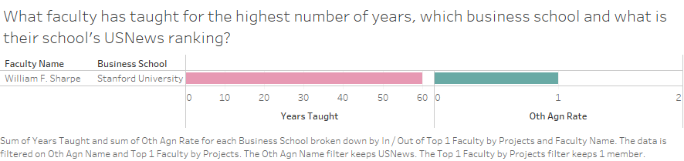

Slide 27
Use cases / Application
2. What is the faculty and their number of publications, in order of publication amount, for the faculty that have Nobel prizes, and what is their corresponding business schools?
Select table statement:
SELECT f.facName AS 'Faculty Name', f.facNumProjects AS 'Number of Publications', w.busName AS 'Business School'
FROM [TA03.Faculty] f, [TA03.Work] w
WHERE f.facNumberNobel > 0 AND f.facName = w.facName
ORDER BY f.facNumProjects DESC

Slide 28
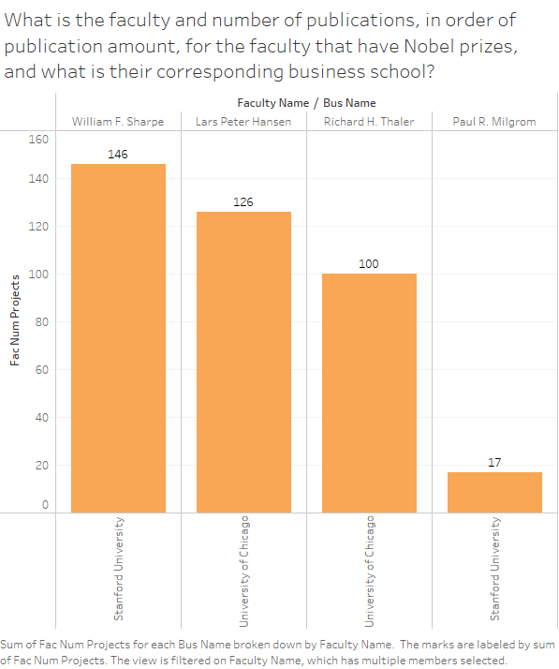
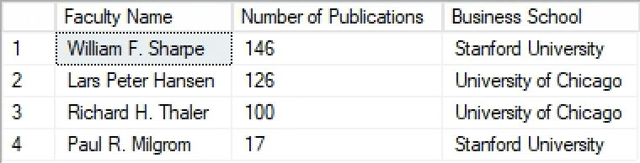

Slide 29
Use cases / Application
3. What is the relationship between the USNews ranking and the financial support in terms of donations to the school, in order of donations?
Select table statement:
SELECT d.busName AS 'Business School', SUM(d.donAmount) AS 'Donation Received', r.othAgnRate AS 'USNews Ranking'
FROM [TA03.Donation] d, [TA03.Rate] r
WHERE r.othAgnName = 'USNews' AND r.busName=d.busName AND d.donAmount IS NOT NULL
GROUP BY d.busName, r.othAgnRate
ORDER BY SUM(d.donAmount) DESC

Slide 30
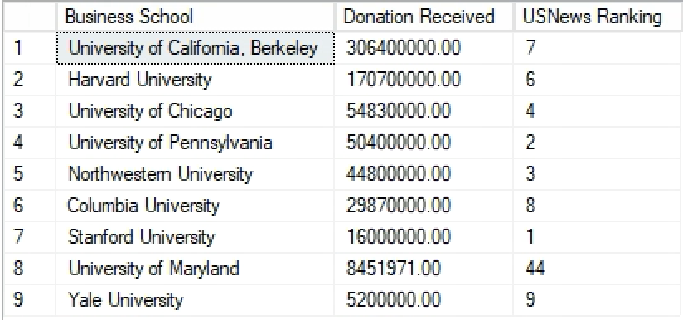
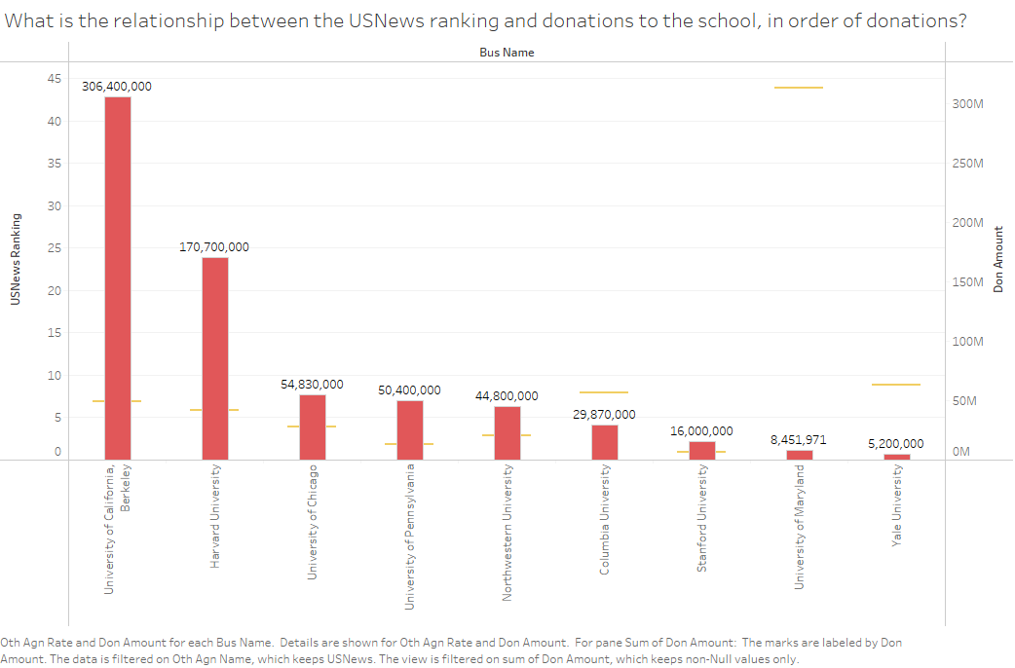

Slide 31
Use cases / Application
4. What is the comparison between the USNews Ranking and the average of the agency rankings, in order of USNews Ranking for each business school?
Select table statement:
SELECT USNews.othAgnRate AS USNewsRating, avg.averageRating, avg.busName
FROM (
SELECT AVG(r.othAgnRate) AS averageRating, r.busName
FROM [TA03.Rate] r
GROUP BY r.busName) AS avg, (
SELECT r.othAgnRate, r.busName
FROM [TA03.Rate] r
WHERE r.othAgnName = 'USNews') AS USNews
WHERE avg.busName = usNews.busName
ORDER BY USNews.othAgnRate, avg.averageRating;

Slide 32
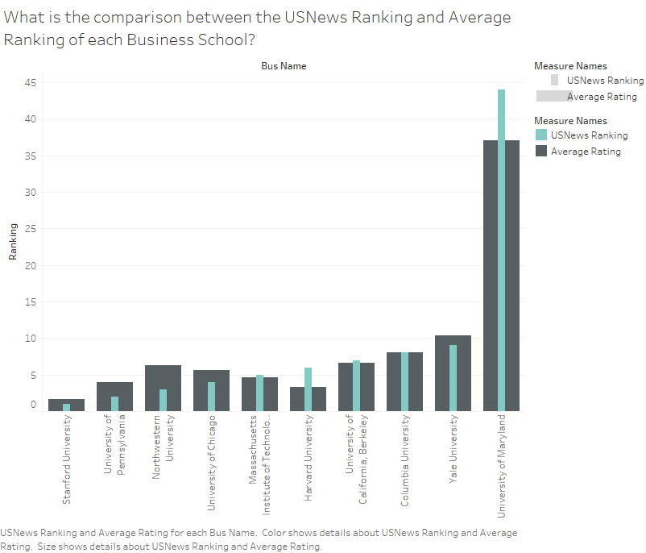
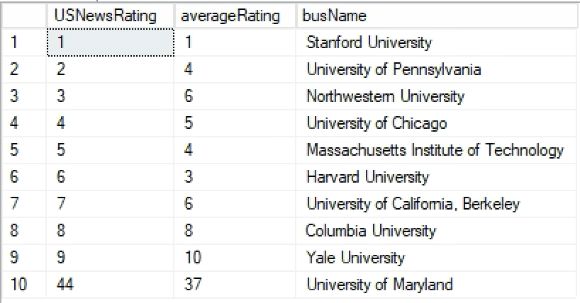

Slide 33
Use cases / Application
5. What 5 faculty had the highest number of awards, and what is their corresponding business school’s USNews ranking?
Select table statement:
SELECT TOP 5 f.facName AS 'Faculty Name', f.facNumAwards AS 'Number of Awards', w.busName AS 'Business School', r.othAgnRate AS 'USNews Ranking'
FROM [TA03.Faculty] f, [TA03.Work] w, [TA03.Rate] r
WHERE f.facName = w.facName AND w.busName = r.busName AND r.othAgnName = 'USNews'
ORDER BY f.facNumAwards DESC

Slide 34
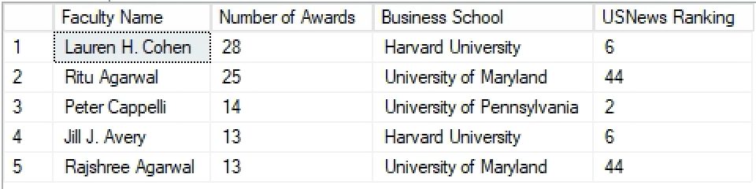
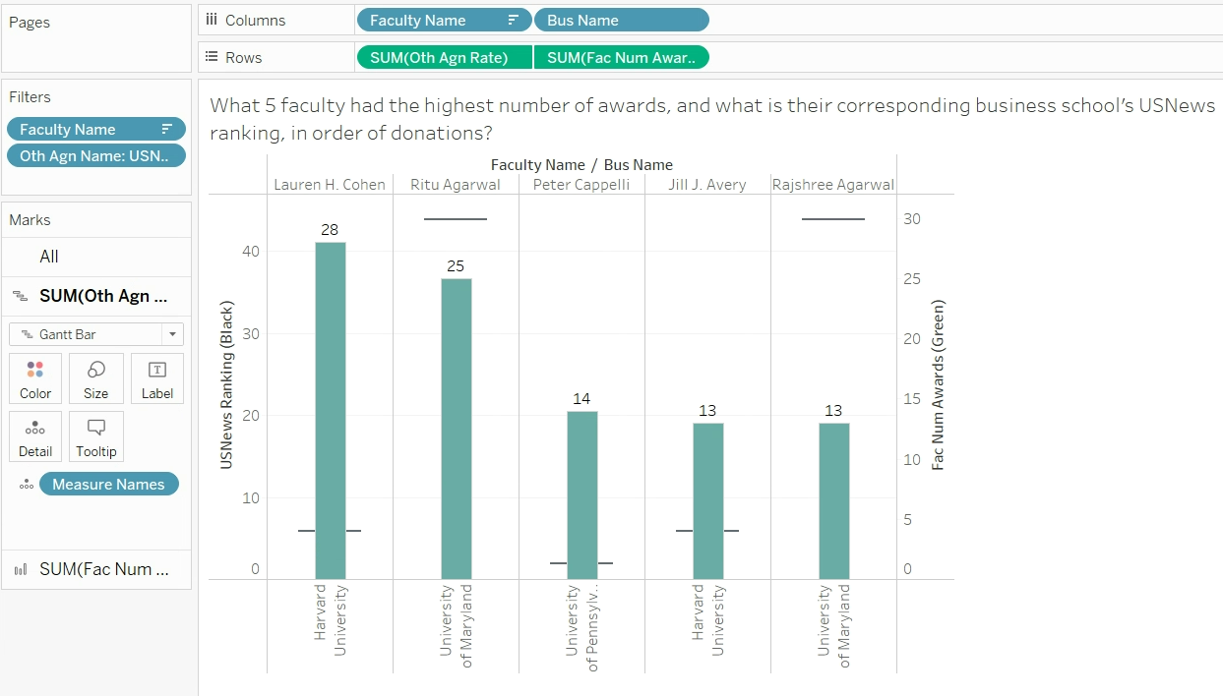

Slide 35
Use cases / Application
6. What is the relationship between the proportion of female students and the USNews ranking?
Select table statement:
SELECT b.busName,r.othAgnName,r.othAgnRate, b.busProFemStudents
FROM [TA03.Rate] r, [TA03.BusinessSchool] b
WHERE r.othAgnName='USNews'
AND r.busName=b.busName
ORDER BY busProFemStudents DESC;

Slide 36
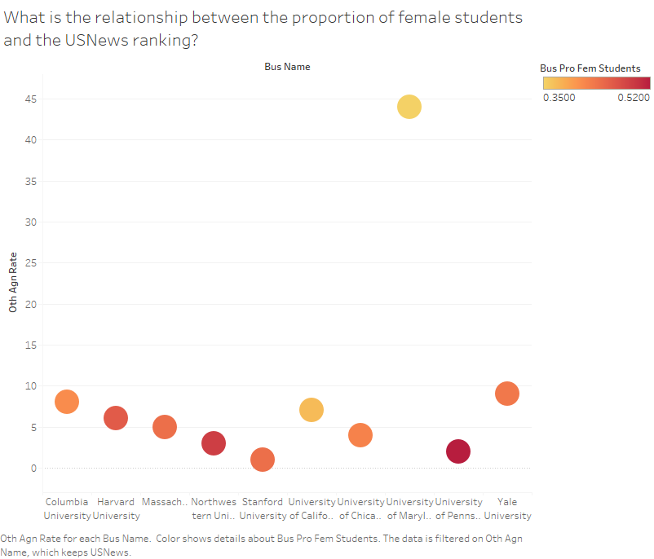
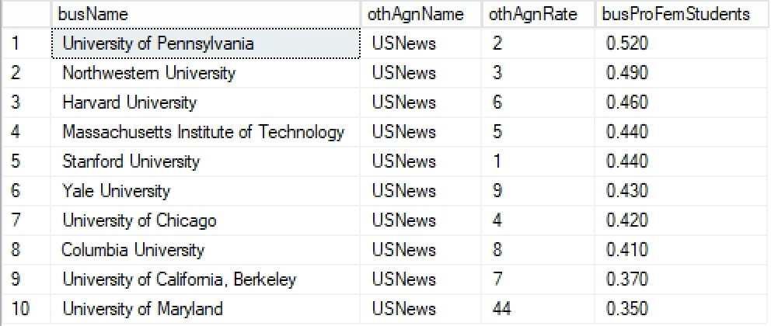

Slide 37
Use cases / Application
7. What is the relationship between the proportion of the international students and the USNews ranking?
Select table statement:
SELECT b.busName,r.othAgnName,r.othAgnRate, b.busProIntStudents
FROM [TA03.Rate] r, [TA03.BusinessSchool] b
WHERE r.othAgnName='USNews'
AND r.busName=b.busName
ORDER BY busProIntStudents DESC;

Slide 38
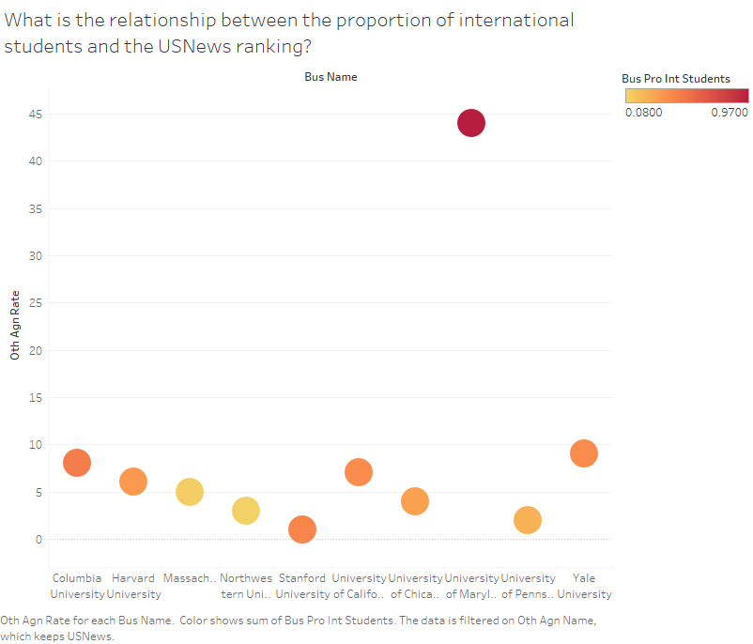
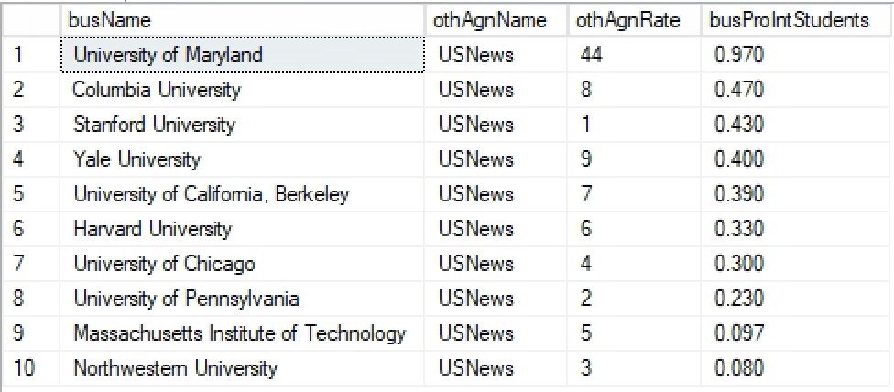

Slide 39
Use cases / Application
8. What is the relationship between employment rate, salary, and USNews Ranking, in order of employment rate and highest salary?
Select table statement:
SELECT b.busName, r.othAgnName, r.othAgnRate, b.busEmpRate, b.busAvgSalary
FROM [TA03.Rate] r, [TA03.BusinessSchool] b
WHERE r.othAgnName='USNews' and r.busName=b.busName
ORDER BY b.busEmpRate DESC

Slide 40
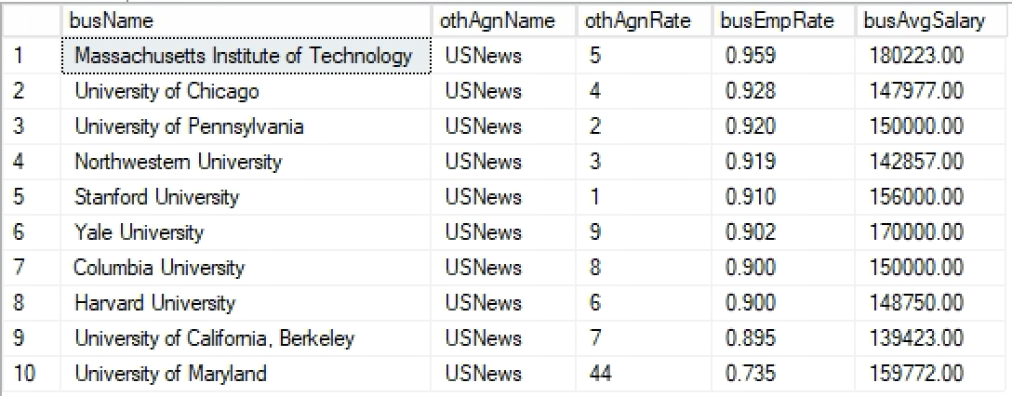
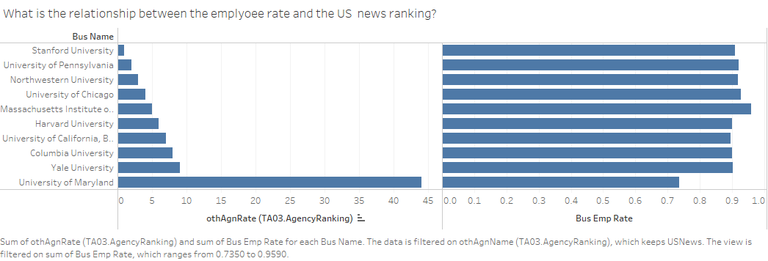
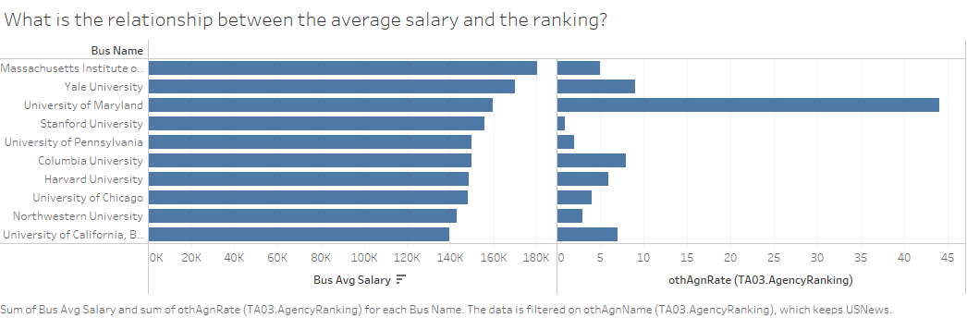

Slide 41
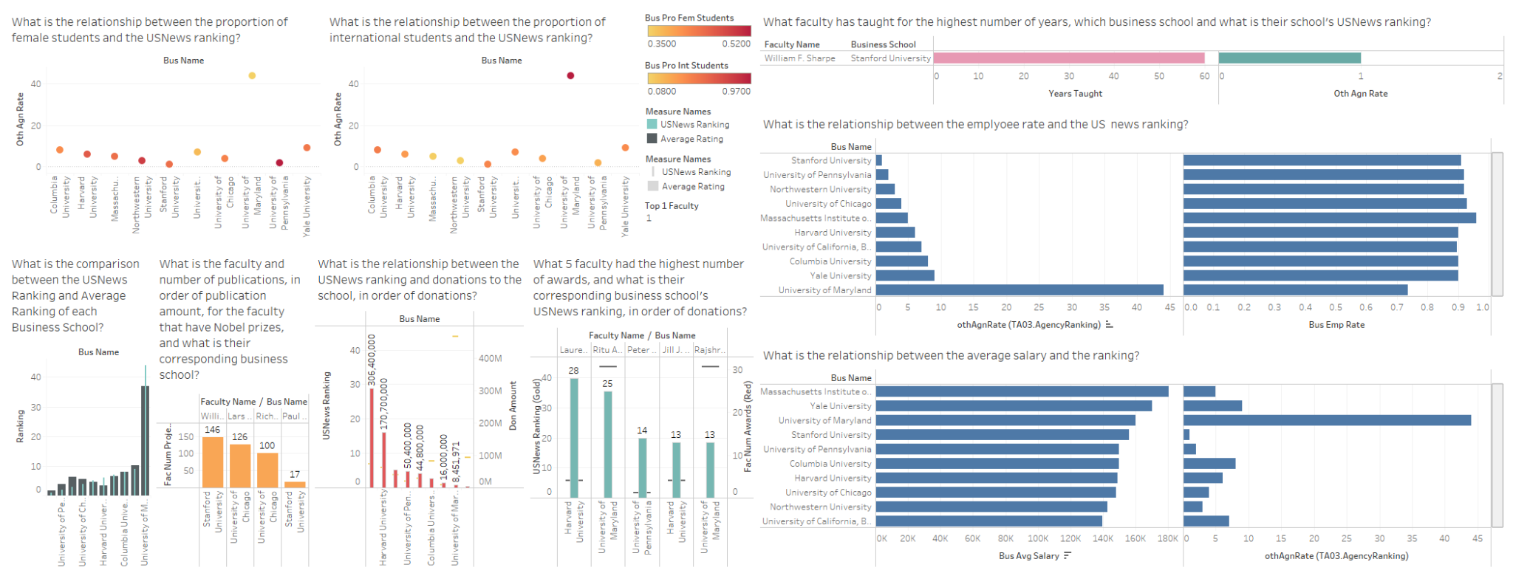
Use Cases / Application - Dashboard

Slide 42
Thanks!
ANY QUESTIONS?

